Slide 1

Australian Household Consumption and Expenditure Pattern
A discovery study from 2012 – 2022
Presented by:
Emma H, Kit N, Md Muhasenul H
7 November 2022

Slide 2
Project Proposal
We seek to uncover the trend and pattern in Australian household consumption and expenditure.
We examine where do fellow Aussies spend their money. How has the consumption pattern changed over the last ten years?
We explore if there is any possible Covid pandemic stimulated changes in consumption pattern. What are some of the possible explanations?
We examine the relationships between Australian household consumption pattern and two key economic indicator: unemployment and household saving.
We further examine the relationships between Australian household consumption pattern and ASX 200 index.

Slide 3
Data
To study the Australian household final consumption and expenditure pattern, we have used:
Household final consumption expenditure, chain volume measures, seasonally adjusted data published by the Australian Bureau of Statistics (ABS)
To examine relationships between Australian household consumption pattern and key economic indicators, economic data are source from ABS. Data used are:
Unemployment rate, seasonally adjusted
Household saving ratio, seasonally adjusted
What are chain volume measures?
Chain volume measures are constant price estimates. This metric measures consumption volumes by removing the part inflated by price increases. It provides better indication of movement in expenditure.
What is seasonally adjusted data?
Seasonally adjusted mean the data has been modified to eliminate the effect of seasonal and calendar influences. The seasonally adjusted data better reflect the true patterns in the underlying consumption activity.
It allows for more meaningful comparisons from period to period.

Slide 4
Data Cleanup and Exploration
Download
Data made available by ABS can be downloaded as CSV files.
Generally, the data from ABS is relatively clean (i.e. format is consistent, no missing values or duplication).
Identify the relevant time series
Within the same csv, the time series that we are interested in are made available in different type (trend, original and seasonally adjusted).
Create new csv files
We manually copy and paste the seasonally adjusted time series and filter for the study period 2012-2022 into a new csv.
Additional checking before analysis
These csv files are then read into a pandas Dataframe for further analysis.
Once it’s in a dataframe, we check for missing values and duplication to identify potential copy and paste error in the extraction step.

Slide 5
Data Cleanup and Exploration (cont)
As we explore the different time series, we observe
Time series are in different frequency. Consumption and expenditure is quarterly, unemployment data is monthly, saving ratio data is quarterly.
Decision Point:
What frequency should the study be? Annually

Slide 6
Observations

Slide 7
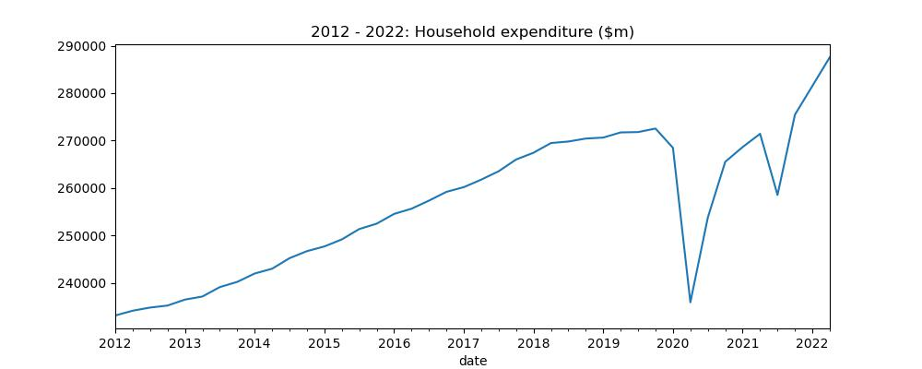
Trend and pattern in Australian household consumption and expenditure
YoY increase
Plateau
Covid impact
Notes:
Talking Point:
We observe an increasing trend in the household spending from 2012 – 2018.
In 2018 – 2019, the increase in spending seems to be plateauing.
If you remember once upon a time, there is this virus named Coronavirus. In late Q1 2020, Australia went into mandatory lockdown. We can see a material decline in consumption and expenditure.
As government lift restrictions, we see the spending increase again.
The second dip in mid 2021 is highly likely as a result of Delta variant stimulated lockdown.
Oct 2021 As we transition to endemic stage / emerge out from pandemic, we see a steep increase in consumption.

Slide 8
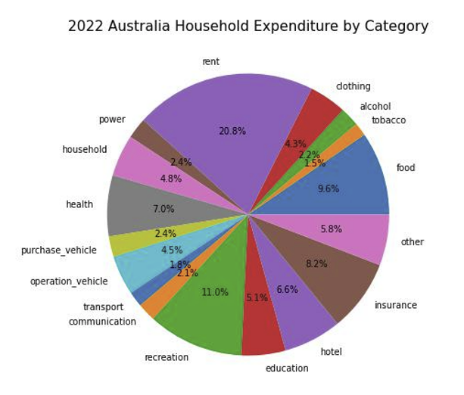
Where do we spend our money?
1
3
2

Slide 9
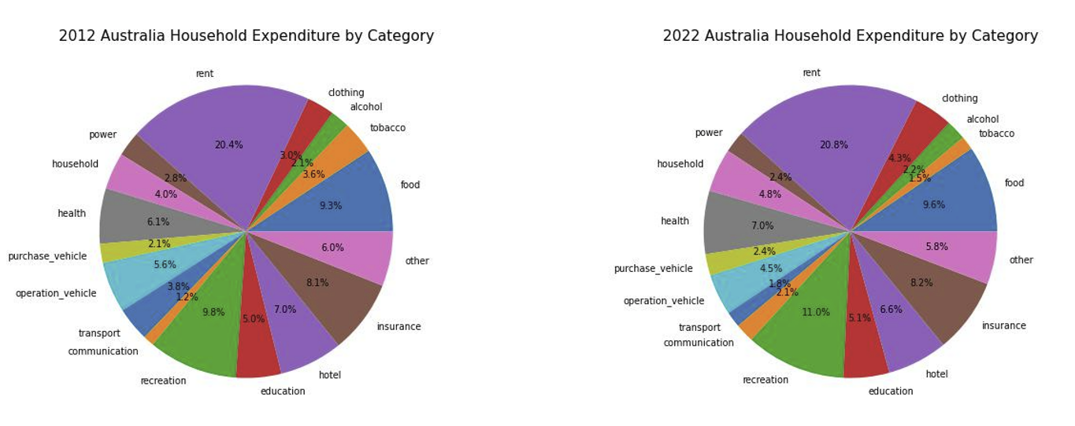
Spending on tobacco almost half in 10 years time
The significant decrease in transport spending could be due to the emerging hybrid working model
Spending on communication almost double in 10 years time
Notes:
Top 3 spending no changes over the last 10 years

Slide 10
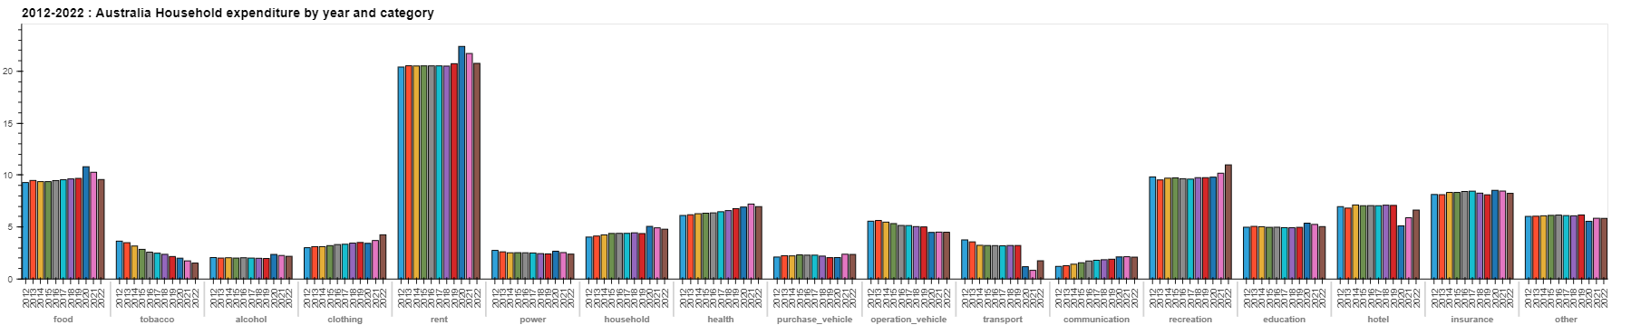
These observed changes in 2020/2021 are likely to be driven by covid pandemic.
Material increase in spending on food and rent
Small increase in spending on education
Significant drop in spending in transport, hotel and eating out.
Massive increase in recreation spending as we emerge out from the pandemic
Decreasing trend in tobacco spending
Increasing spending in communication YoY
Notes:
What are some the possible explanation
Covid stimulated changes.
Rent – looking for bigger place as ppl recognise the need for space as a result of working from home, home-schooling
Food – no where else to spend???
Education – retraining?? As ppl lost their jobs
Transport / hotel and eating out– no surprises. Travel restrictions (i.e. 5km radius/ 10km radius) and mandatory lockdown

Slide 11
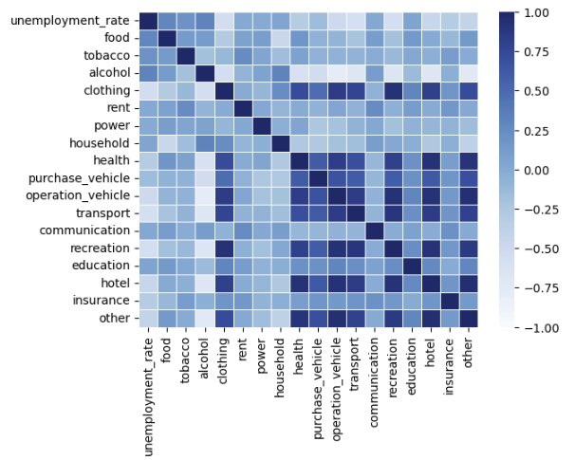
Relationship between unemployment and household consumption
Hypothesis:
As unemployment increases, spending on discretionary items are expected to decrease; spending on necessities are likely to remain unchanged.
Findings:
The results largely agree with the hypothesis. We also found that spending on tobacco and alcohol are slightly positively correlated with unemployment.

Slide 12
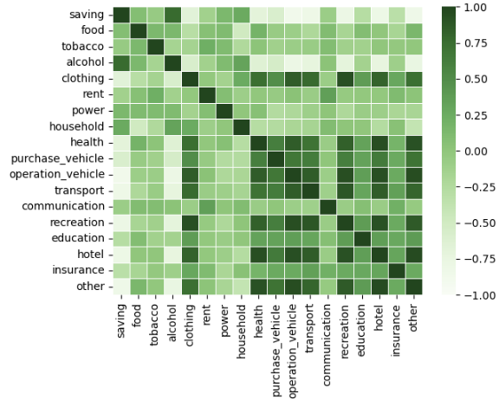
Relationship between household saving and household consumption pattern
Hypothesis:
Increase in saving means less spending in absolute dollar terms. We expect the proportion spent on discretionary items are likely to decrease and proportion spent on necessities remains largely unchanged.
Findings:
The results largely agree with the hypothesis. We also found that spending on alcohol are positively correlated with saving.

Slide 13
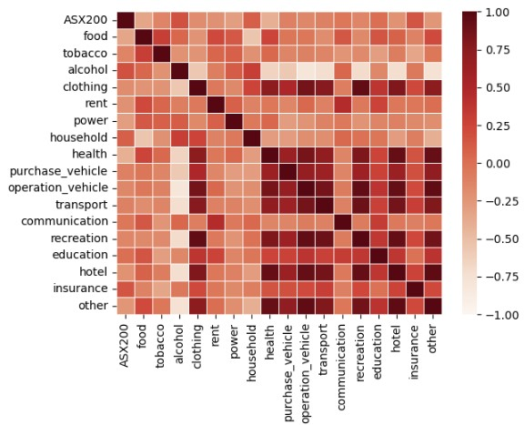
Relationship between ASX 200 and household consumption pattern
Hypothesis:
There is no relationship between ASX 200 returns and household consumption pattern.
Findings:
The results support the hypothesis.

Slide 14
Future Development
There is an obvious decreasing trend in tobacco spending. What are the likely drivers of this decreasing trend?
Enhance the granularity of this study including explore further some of the unexpected observations.
States and territories specific study specifically explore if there is any differences in consumption pattern between states and territories

Slide 15

Questions

Slide 16


